Slide 1
General Exam
October 5, 2011

Slide 2
The Physiological Effects of Ocean Acidification on Multiple Life History Stages of the Pacific Oyster, Crassostrea gigas

Slide 3
Outline
Objectives
Background
  Climate change and OA
  Organism response
Objective 1: Larval oysters and OA
Objective 2: Juvenile oysters and multiple stressors
Objective 3: Adult oyster fitness under OA
When will I be done?

Slide 4
Objectives
To characterize how ocean acidification affects larval oyster growth, development, calcification, and physiology through controlled laboratory experiments with different levels of pCO₂.
To discover how exposure to acidic conditions affects juvenile oyster response to a secondary stressor by measuring growth, gene expression, protein expression, and response to heat shock.
To quantify how conditioning of adult oysters in acidic water affects their fitness.

Slide 5
Climate Change
Ocean acidification – concentration of CO₂ in the atmosphere is in equilibrium with seawater
What does this mean for ocean chemistry?
CO₂ (g)
CO₂ (aq) + H₂O
H₂CO₃
H⁺ + HCO₃⁻
H⁺ + CO₃²⁻
Equilibrium lies in this direction AND
excess H⁺ interacts with CO₃²⁻ in solution

Slide 6
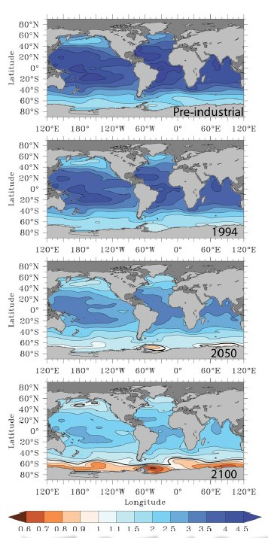
Climate Change
Excess H⁺ in the ocean will decrease pH
More CO₂ will increase dissolved inorganic carbon
Total alkalinity could change depending on biological changes – although not directly from CO₂
The saturation state of calcium carbonate will decrease
Fabry et al. 2008
Notes:
DIC goes up, pH goes down, TA = ?
Most research has been based on the open ocean – the nearshore environment is much more variable and we’re not really sure what is happening now or what will happen (TA, respiration, photosynthesis, tidal influences, riverine influences)
The higher TA of PS waters makes the contribution to OA of anthro CO2 less

Slide 7
Organism Response
Changes in extra- and intracellular pH
  Possibility of buffering with HCO₃⁻
Membrane proteins could correct H⁺ imbalance
Shell dissolution common at all life stages
Changes in gene and protein expression:
  Energy metabolism
  Molecular chaperones
  Respiration
  Ion transport
  Calcification
  Metabolism
  Development
Notes:
Stress but also acclimatization

Slide 8
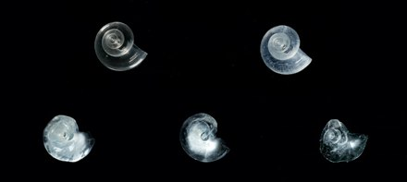
Organism Response
At all life stages, attempts to maintain homeostasis under acidic conditions comes with energetic costs
Exposure to secondary stressors after OA results in a decreased ability to cope
Notes:
Additive, synergistic
The natural environment means multiple changes occur at once

Slide 9
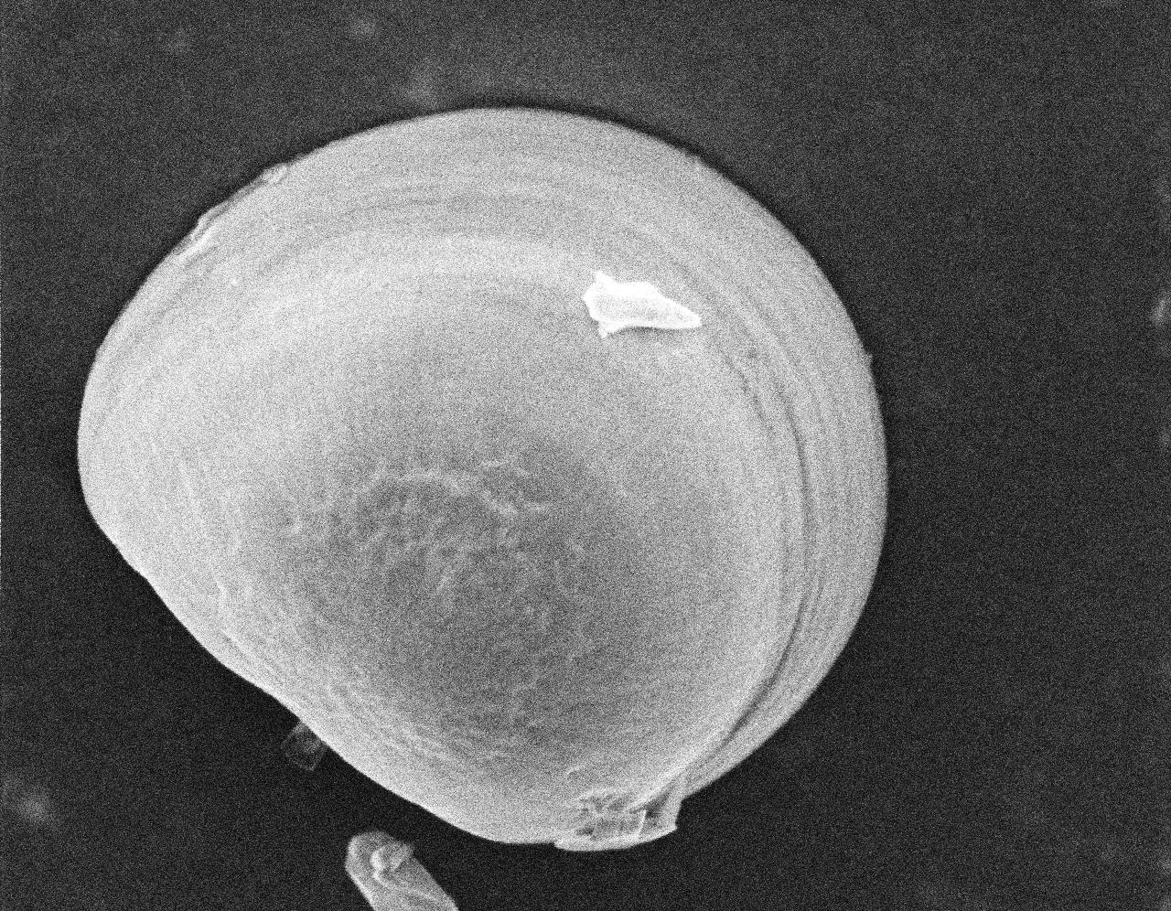
Objective 1
To characterize how ocean acidification affects larval oyster growth, development, calcification, and physiology through controlled laboratory experiments with different levels of pCO₂.

Slide 10
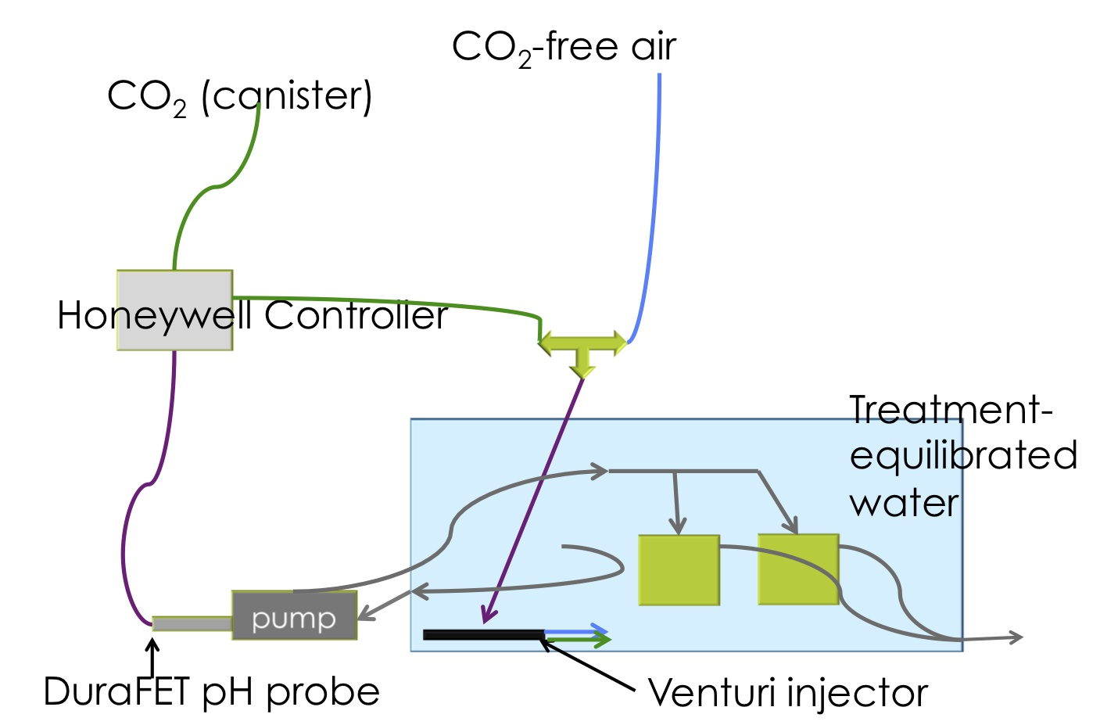
OA System at FHL
Notes:
Ion-sensitive field-effect transistor

Slide 11
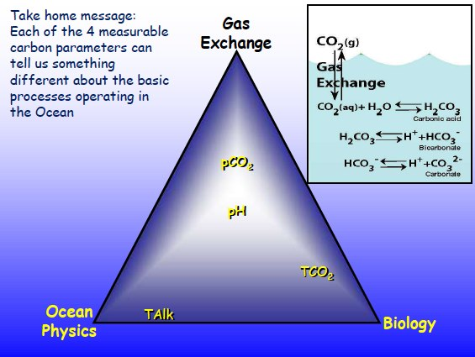
Methods
Chemistry measurements
  pH
  DIC
  TA
  Temperature, salinity
Larval measurements
  Density
  Developmental stage
  Size and growth
  Calcification
  Molecular physiology (transcriptomics)

Slide 12
Methods: Gene Expression
Shell mineralization
Larval oysters show developmental and calcification abnormalities under high pCO₂ (Kurihara et al. 2007)
Shell corrosion and pitting in larval mussels, Sydney rock oysters (Bechmann et al. 2011, Watson et al. 2009, Parker et al. 2010)
Decreased size in mussels, Sydney rock oysters, brittlestar, sea urchin, and barnacle (Bechmann et al. 2011, Watson et al. 2009, Parker et al. 2010, Dupont et al. 2008, Martin et al. 2011, Findlay et al. 2009)
Urchin larvae show changes in expression of genes involved in biomineralization (Martin et al. 2011)

Slide 13
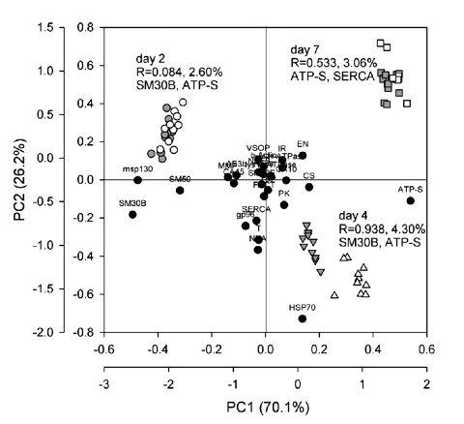
Methods: Gene Expression
Oxidative stress
After 2 weeks, adult C. virginica increased expression of oxidative stress proteins at pH 7.5 compared to 8.3 (Tomanek et al. 2011)
Larval sea urchins increase expression of genes in cellular stress response (Stumpp et al. 2011)
Stumpp et al. 2011
Notes:
Gray = pH 8.1, white = pH 7.7
Black circles are loadings for each gene
Hypotheses for CO2 and oxidative stress: CO2 reacts with peroxynitrite, which would oxidize multpile cellular compounds; impact mitochondrial function and/or non-enzymatic production of free radicals; oysters are not able to reuglate pH well = acidosis leading to leaky ETC

Slide 14
Methods: Gene Expression
Molecular chaperones
Short-term vs. long-term low pH exposure have different effects on sea star expression of Hsp70 (Hernroth et al. 2011)
Larval barnacles changed expression of molecular chaperones at pH 7.6 (Wong et al. 2011)

Slide 15
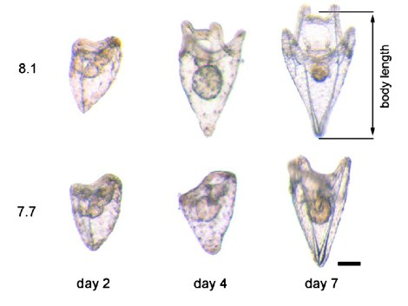
Methods: Gene Expression
Energy metabolism
Barnacle and urchin larvae changed expression of energy metabolism proteins/genes at low pH (Wong et al. 2011, Stumpp et al. 2011)
Evidence of changes in energy budget – delayed development and decreased SfG in urchins (Stumpp et al. 2011)
Stumpp et al. 2011
Notes:
Decreased expression of ATPases could = shift to more efficient transporters (urchins)

Slide 16
Methods: Statistics
Larval size: ANOVA + Tukey’s HSD
Developmental stage, density, calcification: GLM
Gene expression: t-test

Slide 20
Dissolution
threshold

Slide 21

Significantly fewer larvae are in an advanced developmental stage at higher pCO₂ (lower pH)
Notes:
P=2.94e-15

Slide 22
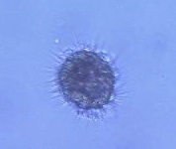
More larvae have started calcification at higher pCO₂
Notes:
P=0.03 for differences between treatments

Slide 23
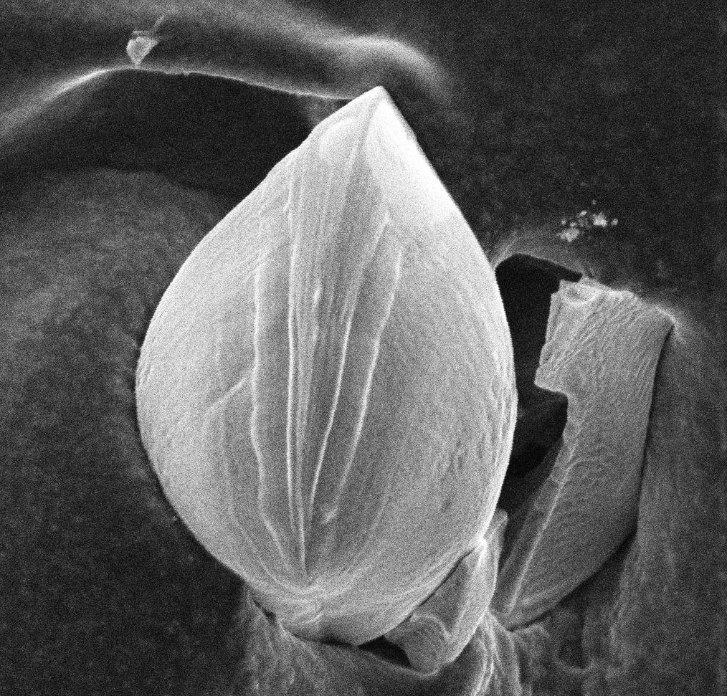
Fewer larvae are fully calcified in the highest pCO₂ (lowest pH) treatment
Notes:
P=0.001

Slide 24
Larvae are smaller at higher pCO₂ at 3 days post-fertilization

Slide 25
Shell height growth rate is slower at the highest pCO₂

Slide 26
Significance
Recent studies have shown that OA effects on larval stages continue to affect growth and survival at later stages
Knowledge about how carbonate chemistry affects larval stages can help mitigate effects in the hatchery (Barton et al. in press)
Notes:
There is a cost to OA – growth, calcification
What are the molecular underpinnings of this cost? Where is the energy budget being spent?

Slide 27
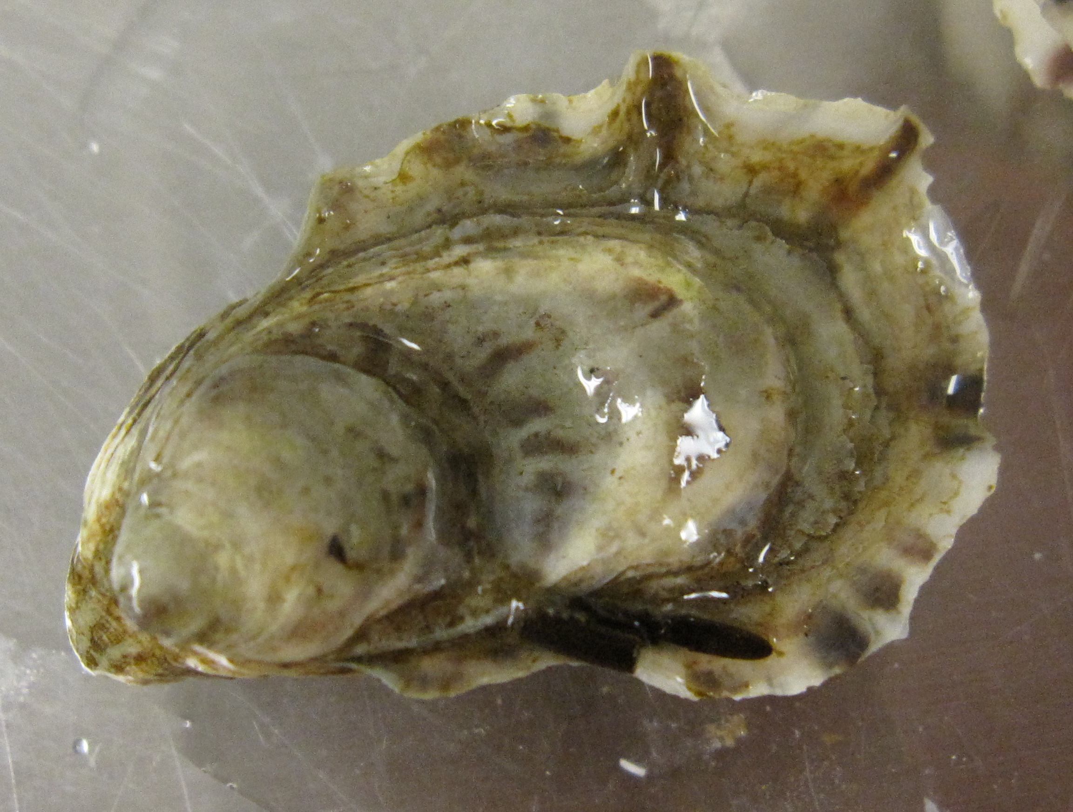
Objective 2
To discover how exposure to acidic conditions affects juvenile oyster response to a secondary stressor by measuring growth, gene expression, protein expression, and response to heat shock.

Slide 28
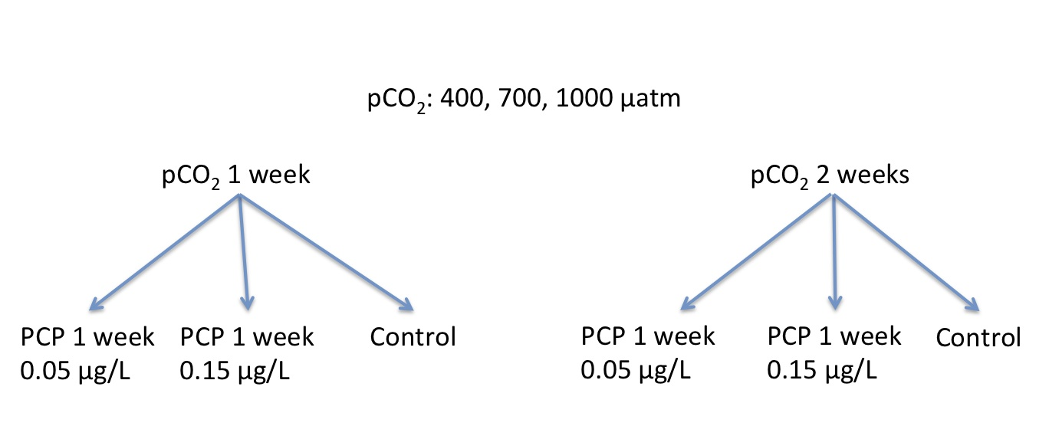
Methods
Notes:
PCP affects vertebrate endocrine system
C. Gigas do not metabolize much PCP, rid themselves via depuration; the most PCP is absorbed in the viscera

Slide 29
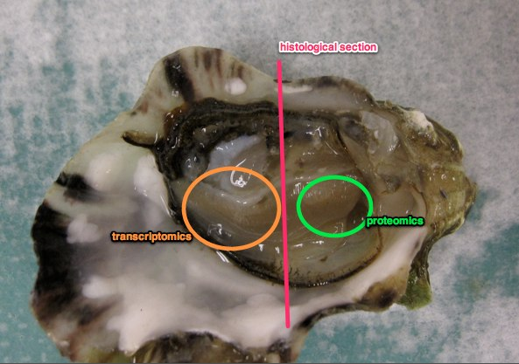
Methods
Histology
Cross-section of gill tissue and digestive gland
  Hemocyte influx
  Metaplasia
  Abnormal cell morphology
  Unhealthy/dying tissue
  Immuno-fluorescent antibody test for Hsp70 expression

Slide 30
Methods
Shell protein content
What is the shell growth/calcification response?
Many bivalves dissolve their shells at high pCO₂ to buffer changes in pH (Pörtner et al. 2004)
CaCO₃ in shells contains protein between the crystals
Changes in shell chemistry? Energy allocation to growth?

Slide 31
Methods
Transcriptomics
What is the transcriptional response?
NGS
  Pool cDNA from high PCP-exposed and non-PCP-exposed oysters from each pCO₂ treatment (12 exposures)
  Differentially regulated genes will be annotated using blastx
qPCR
  Individuals from all treatment groups
  Genes: shell mineralization, oxidative stress, molecular chaperones, energy metabolism, acid-base balance, ETC
Notes:
Global/holistic assay
Oysters may not be able to regulate pHe
Mussels increased NH4+ excretion – proton removal, energy loss
Change in expression of calcifying genes

Slide 32
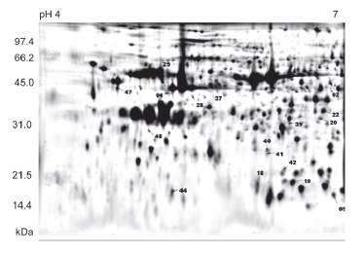
Methods
Proteomics
What is the functional protein response?
  How does it relate to the transcriptional response?
2D SDS/PAGE
Barnacles and oysters have shown shifts in protein expression at low pH (Tomanek et al. 2011; Wong et al. 2011)
Tomanek et al. 2011
Notes:
Global approach
Proteins separated by mass and isoelectric point

Slide 33
Methods
Heat shock response
What is the functional morphology response?
  Reflects the ability to acclimate
Find the LHT (next week)
SLT exposure followed by LHT exposure at times post-SLT
  0 hours
  2 days
  14 days
Gene and protein expression of hsp70/Hsp70 following SLT and LHT

Slide 34
Methods: Statistics
Mortality, histology measurements, qPCR, hsp70 and Hsp70 expression: ANOVA with pCO₂ and PCP treatments as fixed effects
NGS data:
  transform sequence counts into RPKM
  Chi square to compare between treatment groups
  Correct for multiple hypotheses with Qvalue
Proteomics: t-test
Notes:
Reads per kilobase per million mapped reads – standardizes the sequence counts as functions of the contig length and the absolute data set size
Positive false discovery rate (pFDR): fixes rejection region then estimates alpha (probability of type I error); has greater power because rejects a greater number of hypotheses while controlling the same error rate; tests multiple hypotheses at once

Slide 35
Start exp
9/27

Slide 37
C
C

Slide 38
C
C

Slide 39
Significance
Integrative response to multiple stressors
Detail of molecular and physiological plasticity available to the oyster
Notes:
Relationship between transcription, translation, and phenotype
Development of biomarkers?

Slide 40
Possible Problems
2 weeks may not be long enough for the “long exposure”
  What about 1 month?
Oysters change the chemistry in 4L jars
  Can be remedied with a flow-through system – FHL?

Slide 41
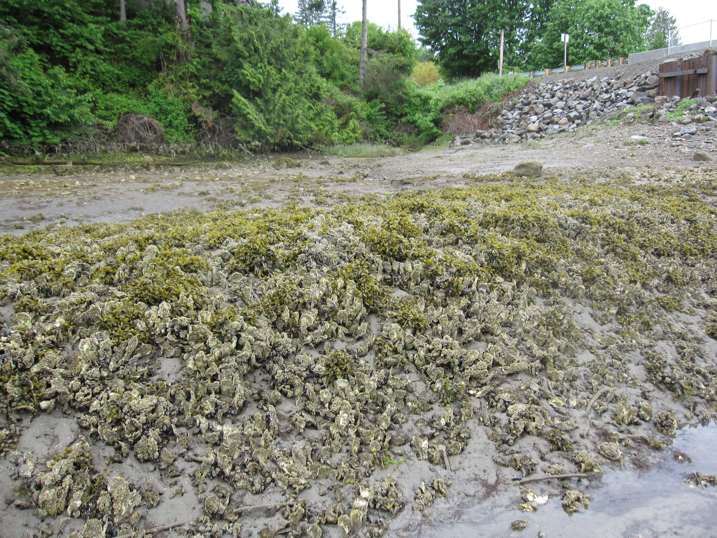
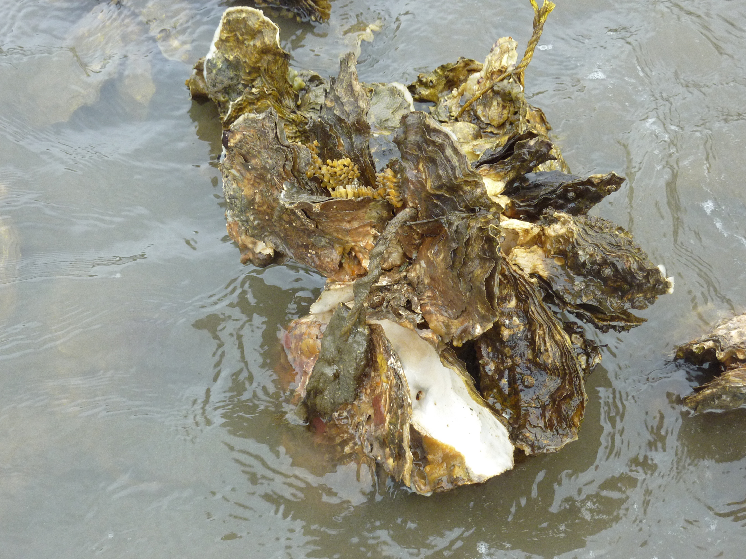
Objective 3
To quantify how conditioning of adult oysters in acidic water affects their fitness.

Slide 42
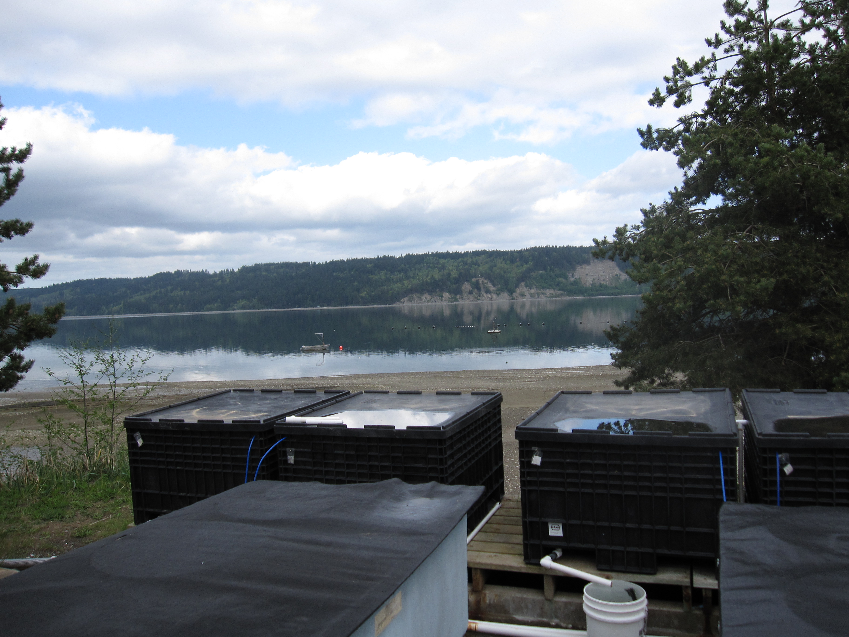
Methods
Acclimatization to water from upper and lower intakes in Dabob Bay
  These water masses maintain separate pH in the late spring-early fall
Acclimatize hatchery (selectively bred) and wild-caught oysters
Sample water for pH, TA, temperature, and salinity

Slide 43
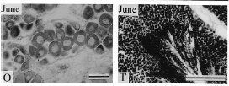
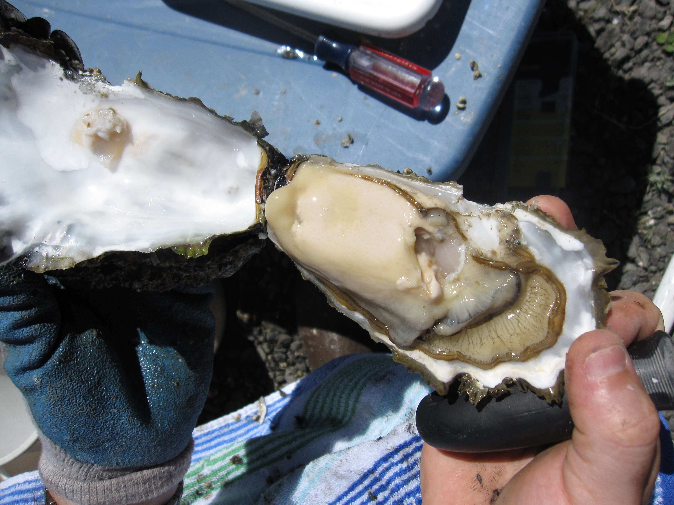
Methods
Gametogenesis
  GSI
  Oocyte diameter
  Glycogen, protein, and lipids
Li et al. 2000

Slide 44
Methods
Six crosses to determine effects of parent origin, pH conditioning, maternal effects
  Deep water intake wild males x DW wild females
  DW hatchery males x DW hatchery females
  Shallow water wild males x SW wild females
  SW hatchery males x SW hatchery females
  DW wild males x SW wild females
  SW wild males x DW wild females
Genotype-dependent survival of larvae
pH effect
Parent origin
Maternal effects
Notes:
Different genotypes cause mortality at different developmental stages
Larvae from selectively bred oysters raised at high pCO2 survived better and grew larger under high pCO2

Slide 45
Methods: Statisitics
Gametogenesis: PCA
  Variables = wild vs. hatchery, GSI, oocyte diameter, glycogen, protein, lipids
Assignment power of SNPs, parentage analysis, allele frequencies: Cervus (likelihood)

Slide 46
Significance
How do environmental stressors (OA) affect oyster fitness?
What are the evolutionary implications of a physiological stress?
How does hatchery selection compare to wild selection?
Notes:
Is genotype-dependent survival affected by adult condition/acclimation?

Slide 47
Possible Problems
24 hours is probably not long enough to raise larvae to understand genotype-dependent survival, nor will they be large enough for single larval DNA extraction
  Raise them for a longer amount of time – larger, early mortality will be over
  Plough & Hedgecock (in press) seem to have extracted DNA from single, early development larvae
  Use RAD sequencing on pooled larvae

Slide 48
Synthesis of Significance
Different life stages have different tolerances and responses
  Where would a potential bottleneck occur?
  Which stage is the most vulnerable?
Biological significance – which physiological pathways are important for acclimation/survival
Ecological significance – each stage occupies a different niche
Evolutionary significance – how will populations respond to ocean acidification

Slide 49
Timeline
= TAship
2011
2012
2013
S O N D J F M A M J J A S O N D J F M A M J J A
Adv Genetic Analysis
Fish Oceanography
Fish & Wildlife Toxicology
Gene Regulation
Proteomics
Applied Pop Gen
Oral exam
Obj 1 analysis
Obj 2 trial
Obj 2 experiment
Analysis
spawn
Obj 3 conditioning
Obj 3 analysis
Write dissertation

Slide 50
Revised Timeline
= TAship
2011
2012
2013
S O N D J F M A M J J A S O N D J F M A M J J A
Adv Genetic Analysis
Proteomics
Applied Pop Gen
Fish Oceanography
Gene Regulation
Oral exam
Obj 1 analysis
Obj 2 trial
Obj 2 experiment
Analysis
Obj 3 conditioning
spawn
Obj 3 analysis
Write dissertation

